Slide 1
Slipping vs. Tipping
Dr. Jacob Moore
Associate Professor of Engineering
Penn State Mont Alto

Slide 2




Why Do Things Tip Over?
When we try to push things along a rough surface, we will often get two couples acting on the body.
The pushing force and the friction force before slipping create one couple.
The gravity force and a shifting normal force create the other opposing couple
$$F_{push}$$
$$F_{g}$$
$$F_{f}$$
$$F_{N}$$

Slide 3










Non-uniform Normal Forces
If we are pushing on an object, the distributed normal force will adapt to try and balance the moment of the friction force.
$$F_{push}$$
$$F_{g}$$
$$F_{g}$$
$$F_{g}$$
$$F_{push}$$
$$F_{f}$$
$$F_{f}$$
$$F_{N}$$
$$F_{N}$$
$$F_{N}$$

Slide 4




Slipping
If the moments exerted by the two couples can cancel each other out right up to the point where the pushing force is larger than the friction force can be, the object will slide along the surface (slip)
$$F_{push}$$
$$F_{g}$$
$$F_{f}$$
$$F_{N}$$

Slide 5

Tipping
If the normal force would have to exist beyond the base of the object before the pushing force exceeds the static friction limit, the object will tip over before it slips.
$$F_{push}$$
$$F_{g}$$
$$F_{f}$$
$$F_{N}$$

Slide 6
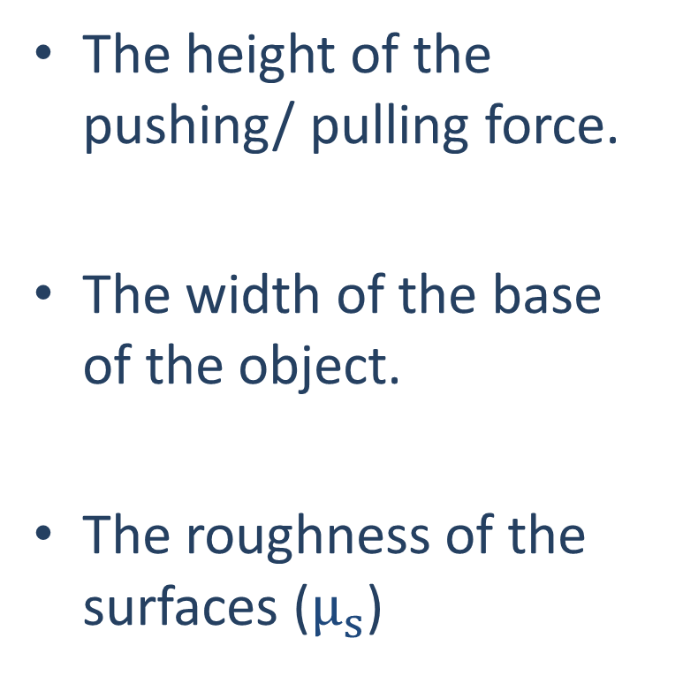

Factors That Affect Slipping vs. Tipping
The height of the pushing/ pulling force.
The width of the base of the object.
The roughness of the surfaces ($μ_{s}$)
$$F_{push}$$
$$F_{g}$$
$$F_{f}$$
$$F_{N}$$

Slide 7
Determining if an Object will Tip or Slip First
Find the force that would be required to make the object slide along the surface.
Assume no tipping.
Find the force that would be required to make the object tip over
Use the moment from the max counter-couple from the weight and normal forces. Assume no slipping.
Whichever option requires a smaller force will be the option that happens first.

Slide 8
Thanks for Watching
See other engineering mechanics videos and access the full tool at…

Slide 9


Slipping vs. Tipping Worked Example
A box with the dimensions shown below is placed on a flat surface. We increase the magnitude of the pushing force until the box either tips over or begins to slide. Which will occur first? Assume the center of mass of the box is at the center point of the box.
m = 60 kg
$$F_{push}$$
$$μ_{s}=.62$$
4m
3m
3m

Slide 10

Slipping vs. Tipping Worked Example
A box with the dimensions shown below is placed on a flat surface. We increase the magnitude of the pushing force until the box either tips over or begins to slide. What is the largest value of d that will allow the box to slide along the surface before it tips over. Assume the center of mass of the box is at the center point of the box.
m = 60 kg
$$μ_{s}=.62$$
$$F_{push}$$
4m
d
3m

Slide 11


Slipping vs. Tipping Worked Example
A pushing force is applied to the box as shown below. The magnitude of the force is increased until the box either tips over or begins to slide. Which will occur first? Assume the center of mass of the box is at the center point of the box.
35º
80 lbs
$$F_{push}$$
$$μ_{s}=.45$$
3 ft
1 ft

Slide 12


Slipping vs. Tipping Worked Example
A 30 lb box with the dimensions shown below is placed on a surface and the angle of that surface is slowly increased until the box either tips over or begins sliding. What will occur first and what angle will this occur at? Assume the center of mass of the box is at the center point of the box.
30 lbs
2 ft
$$μ_{s}=.55$$
1 ft
$$θ$$

